Slide 1
Exploiting Concurrency for Multiprocessing
Language features to exploit parallelism

Slide 2
A parallel program for a multiprocessor consists of 2 or more interacting processes
A process is a sequential program that executes concurrently with other processes
2 processes are concurrent if the first operation of one process starts before the last operation of the other
One way to denote concurrency is to use FORK & JOIN statements

Slide 3
FORK spawns a new process
JOIN waits for a previously created process to terminate
FORK operation may be specified in 3 ways :-
FORK A
FORK A, J
FORK A, J, N
In all usages of FORK statement, the corresponding JOIN statement is expressed as JOIN J

Slide 4
FORK operation may be specified in 3 ways :-
FORK A
FORK A, J
FORK A, J, N
FORK A initiates another process at address A and continues the current process
FORK A, J causes the same action as FORK A & also increments a counter at address J
FORK A, J, N causes the same action as FORK A and sets the counter address J to N

Slide 5
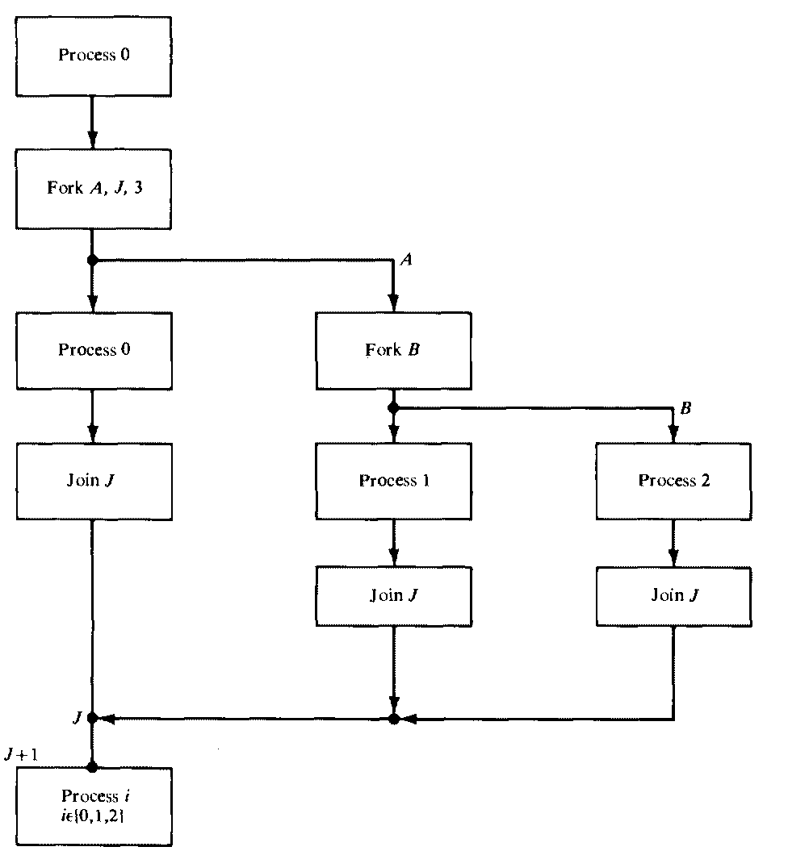
Fork join concept

Slide 6
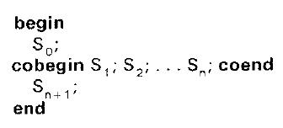
An equivalent extension of FORK-JOIN concept is the block structured language
In this case, each process is a set of n processes S₁ , S₂…. S_{n} which can be executed by using
cobegin-coend(parbegin - parend) constructs
Cobegin declares the parts of a program that may execute concurrently

Slide 7
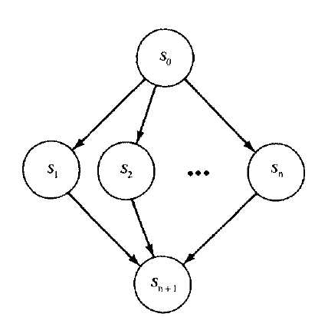

Precedence graph of concurrent program given above :
Block of statements b/w cobegin-coend are executed concurrently only after the execution of statement S₀
Statement S_{n+1} is executed only after the executions of statements S₁ , S₂…. S_{n} have been terminated

Slide 8
Concurrent statement has a single entry & single exit
Processes defined by the concurrent statements are completely independent of one another
Set of statements S₁ , S₂…. S_{n} are executed concurrently as disjoint processes
A variable v_{i} changed by statement S_{i} cannot be referenced by another statement S_{j}

Slide 9
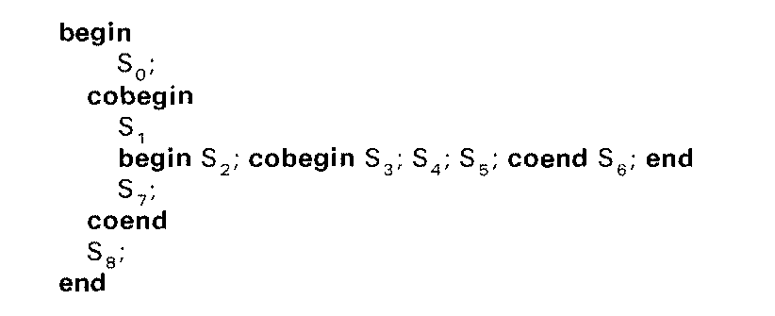
Concurrent statements can be nested arbitrarily

Slide 10
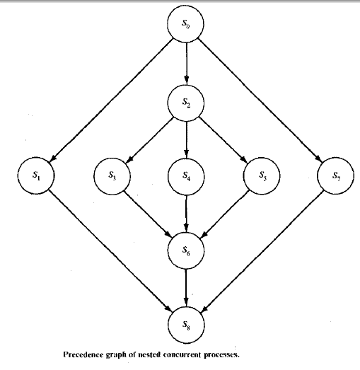
Precedence graph of above process

Slide 11
Parallelism in the execution of statements may be found in loops
5 primitives are listed below to allow easy implementation of parallel for statements
PREP : A parallel path counter PPC is initialized( PPC<-1)
AND(L) : 2 way fork
process at address L is initiated & current process is continued at next instruction
ALSO(L) : as above but without incrementing PPC
JOIN : PPC <- PPC – 1, processor executing JOIN is released
IDLE : terminates a path & releases the processor that was executing it

Slide 12
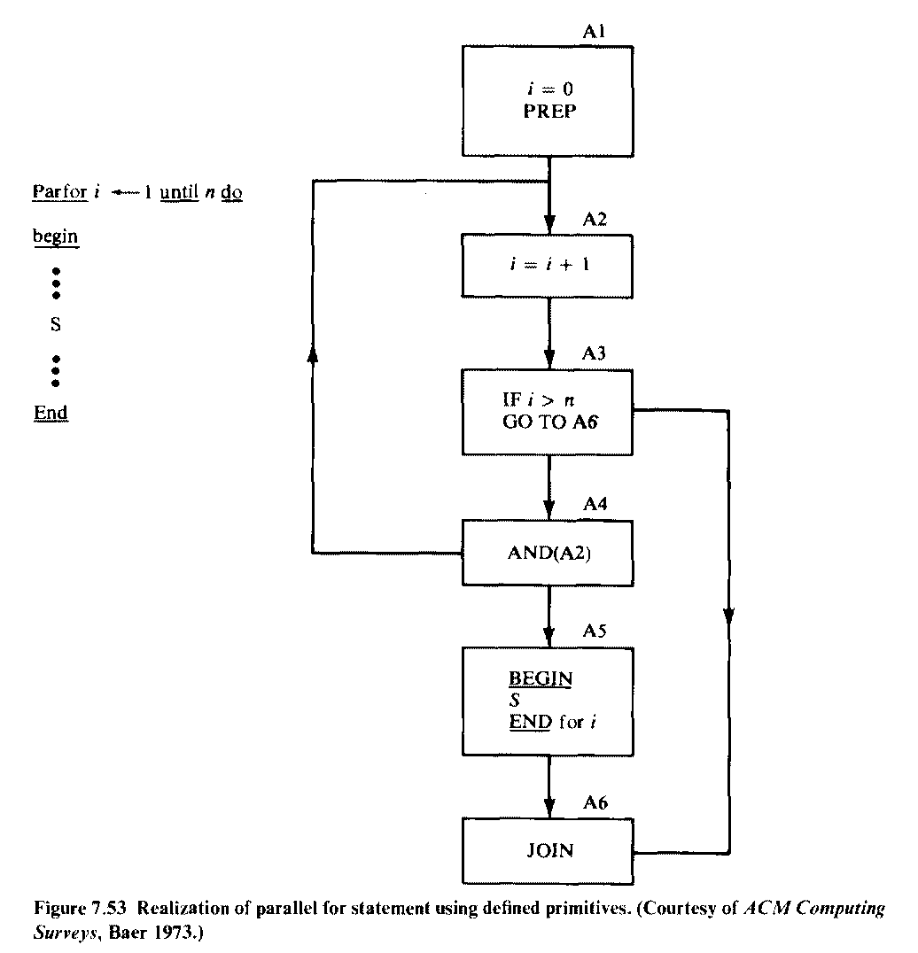
Parallel for statement

Slide 13
A very common problem occurs when 2 or more concurrent process share data which is modifiable
If a process is allowed to access a set of variables that is being updated by another process concurrently, erroneous results will occur
Thus controlled access of shared variables should be required so as to guarantee that a process will have mutually exclusive access to the section of programs
Such set of programs are known as critical sections

Slide 14
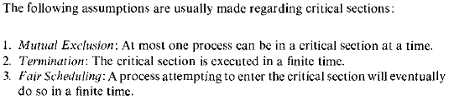

Slide 15
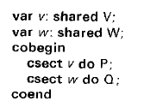
Notation used to declare a set of common or shared variables of type T
var v : shared T
Critical section may be defined as :
csect v do S
Statement S with a common variable v & indicates that statement S should have exclusive access to v
Critical sections referring to different variables executing in parallel :-

Slide 16
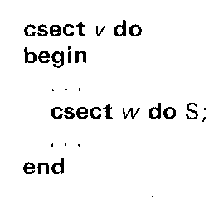
Critical sections can be nested as follows :-

Slide 17
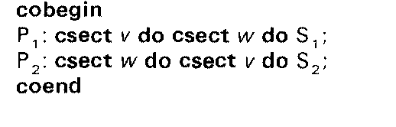
There’s a potential danger of deadlock in which one or more processes are blocked waiting for events
Eg : 2 concurrent processes P1 & P2 may be deadlocked in the parallel program given below
P1 enters section v at the same time P2 enters w
When P1 tries to enter its critical section w, it will be delayed because P2 is already inside its section w
and P2 will be delayed trying to enter its section v, coz P1 is already in section v

Slide 18
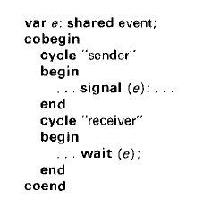
The following program illustrates the transmission of timing signals from one process to another
Shared variable e of type event
Concurrent operations wait & signal, both access the same variable e

